Slide 1

Men NCAA® Machine Learning Competition 2021
IST 718 Big Data Analytics
Max Vasquez
Gilbert Guyah

Slide 2
Objective is to win
Each season there are thousands of NCAA basketball games played between Division I men's teams, culminating in March Madness, the 68-team national championship that starts in the middle of March. As per Forbes.com, this year March Madness gambling is expected to break $8.5 Billion record. The goal is to:
Use historical data to accurately predict the winner of every possible match up in the NCAA Division I Basketball tournament.
Source: https://www.forbes.com/sites/willyakowicz/2021/03/17/march-madness-gamblers-expected-to-break-85-billion-record-thanks-to-mobile-sports-betting-draftkings-westgate/?sh=1a492df3776d

Slide 3
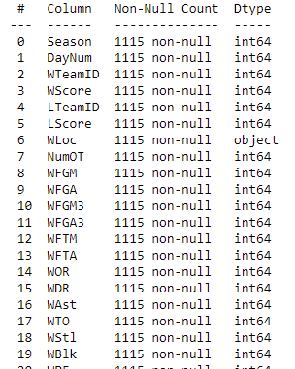
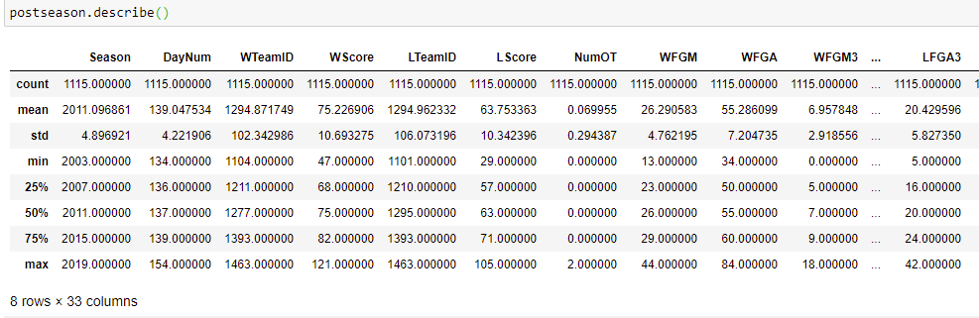
The Fundamentals
The NCAAM Basketball Tournament dataset contains data from several sources.
About the data
The 357 Division-I Teams
Team names, conferences, rankings, location
Tournament seeds since 1984-85 season
Team stats for all regular season, conference tournament, and NCAA® tournament games since 2002-2003 season
Kenneth Massey historical data
Source: https://www.kaggle.com/c/ncaam-march-mania-2021/data

Slide 4
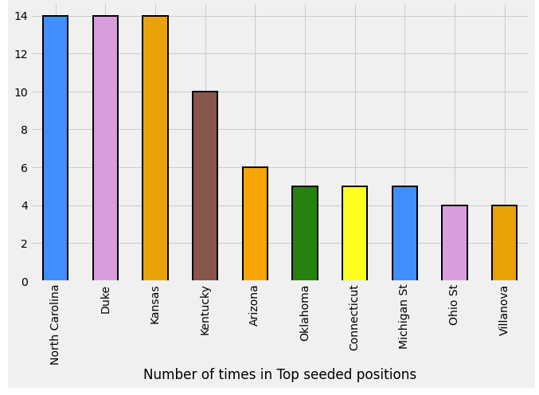
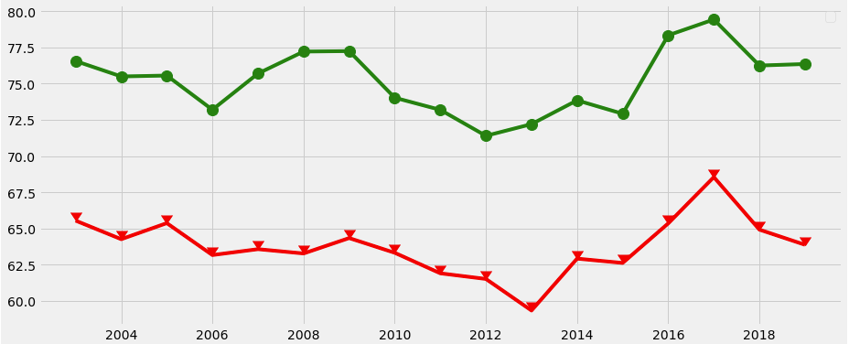
Studying the tapes
North Carolina, Duke, and Kansas ranked the #1 seed the most
Tourney Detailed Results
Winning and Losing score Average over the years
Source: https://www.kaggle.com/c/ncaam-march-mania-2021/data

Slide 5
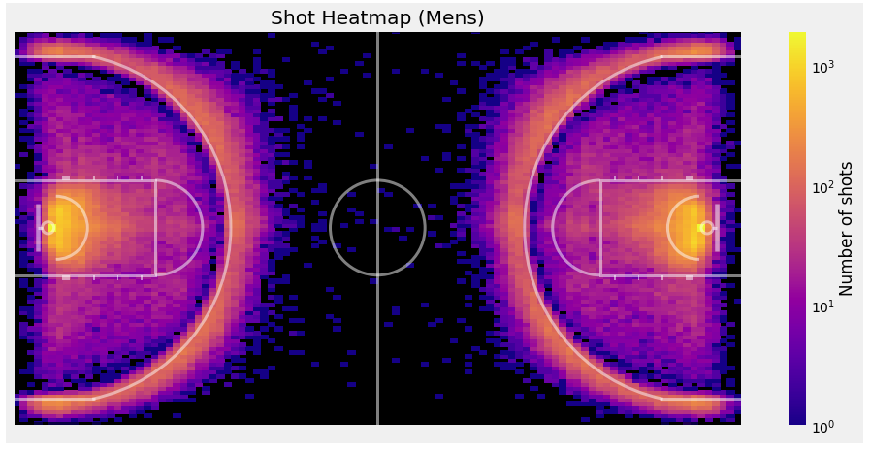
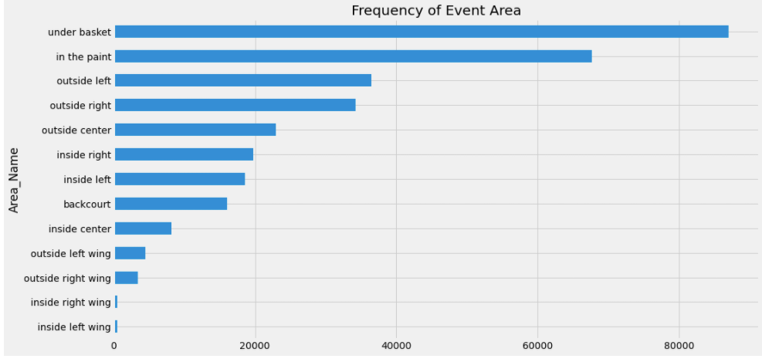
Studying the tapes
Most of the events and shots are taken under the basket
Source: https://www.kaggle.com/c/ncaam-march-mania-2021/data

Slide 6
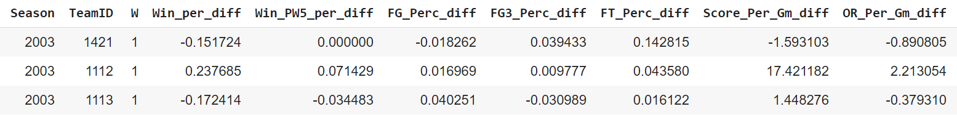
The Playbook
Prepping Training and Test Data
Summarize all team stats performance by season
Calculate the difference of team stats performance between both teams facing each other in the tournament
Training data:
Modeling Techniques:
Contains historical data from 2003 to 2018 seasons
Random Forest
Logistic Regression
KNN
Naïve Bayes
Perceptron
Test data:
The data will be tested against the
2019 tournament
Source: https://www.kaggle.com/c/ncaam-march-mania-2021/data

Slide 7


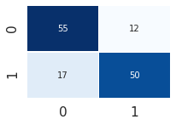

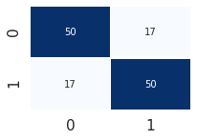





Running The Plays
The models were tested with the 2019 tournament. Random Forest model had the best accuracy in predicting the winner of the most games in the tournament. None of the models predicted the correct champion
Random Forest 1
Random Forest 2
Logistic Regression
n=100
n=300, max features =0.4
default
Acc =0.783582
Acc =0.731343
Acc =0.746269
2019 Champions
Virginia
KNN
Naïve Bayes
Perceptron
n=9
default
max iterations=8
Acc =0.626866
Acc =0.746269
Acc =0.738806
Predicted Winners: Duke, Tennessee, Gonzaga, and North Carolina
Source: https://www.kaggle.com/c/ncaam-march-mania-2021/data

Slide 8
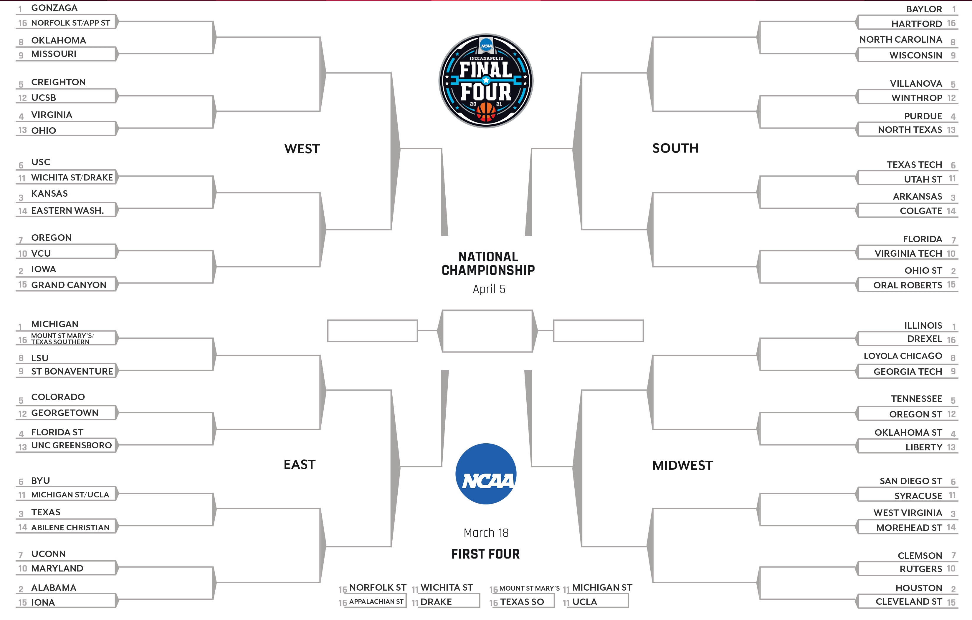
And the projected winner is
GONZAGA
BAYLOR
GONZAGA
BAYLOR
OKLAHOMA
NORTH CAROLINA
GONZAGA
BAYLOR
UCSB
VIRGINIA
WINTHROP
WINTHROP
VIRGINIA
PURDUE
GONZAGA
BAYLOR
USC
TEXAS TECH
KANSAS
ARKANSAS
KANSAS
ARKANSAS
IOWA
OHIO ST
OREGON
FLORIDA
IOWA
OHIO ST
IOWA
OHIO ST
MICHIGAN
GONZAGA
BAYLOR
BAYLOR
ILLINOIS
MICHIGAN
ILLINOIS
LSU
GEORGIA TECH
MICHIGAN
TENNESSEE
COLORADO
TENNESSEE
FLORIDA ST
TENNESSEE
FLORIDA ST
OKLAHOMA ST
MICHIGAN
HOUSTON
UCLA
UCLA
SYRACUSE
SYRACUSE
TEXAS
WEST VIRGINIA
HOUSTON
UCONN
ALABAMA
CLEMSON
ALABAMA
Model: Random Forest 1
HOUSTON
ALABAMA
HOUSTON

Slide 9
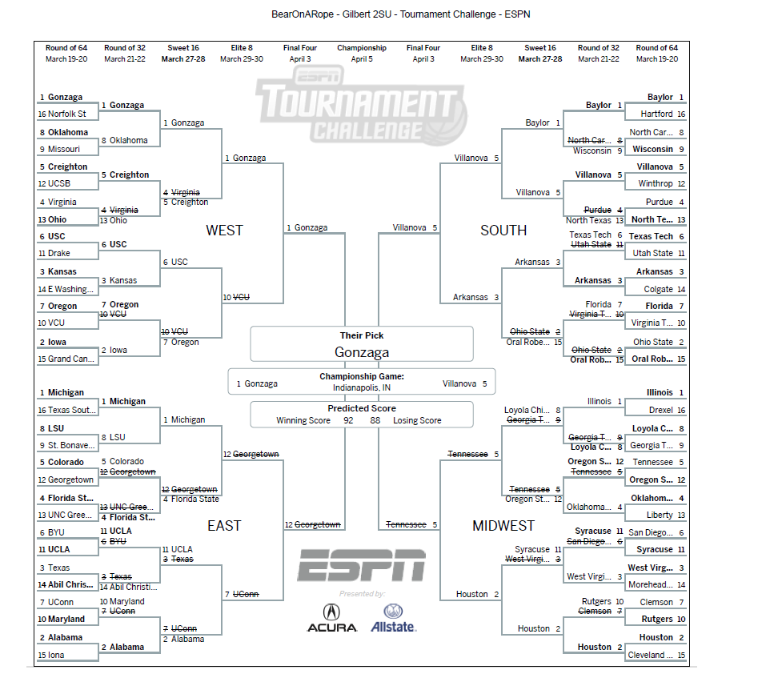
ESPN 2SU Bracket

Slide 10
Post Game Interview
Any Questions?

Slide 11
Coaches:
Goodfellow, Ian, Yoshua Bengio, and Aaron Courville, Deep Learning (DL), MIT Press, 2016
Kaggle Data Dictionary Retrieved from https://www.kaggle.com/c/ncaam-march-mania-2021/data
James, Gareth, Daniela Witten, Trevor Hastie, and Robert Tibshirani, An Introduction to Statistical Learning with Applications in R, Springer, 2013.
Miller, Thomas W., Modeling Techniques in Predictive Analytics with Python and R, Pearson, 2015

